Slide 1
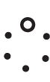
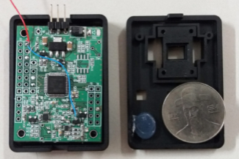
SENSORTOPIA ITEM
* RAIN SENSOR (vehicle)
*PCB PATTERN COIL & MODULE for OIS (OIS ACTUATOR for camera module)
Development
Purpose
Success
SENSORTOPIA CO., Ltd
HAN, Sea-Yeoun (010-2036-8659)
www.sensortopia.co.kr

Slide 2
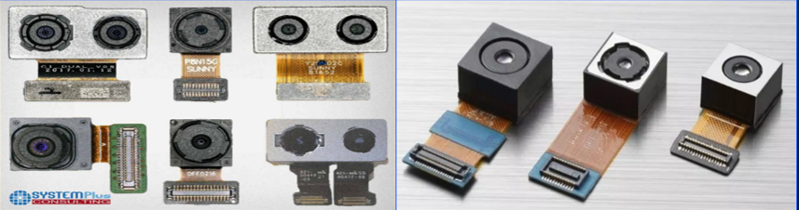
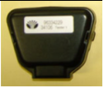

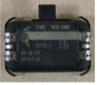
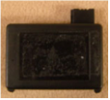
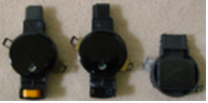
Contents
History
Patent Status
PCB PATTERN COIL & MODULE for OIS
3-1. Development Item Summary
3-2. Technology Development and Implementation
3-3. Market Size
3-4. Competitor Status
RAIN SENSOR
4-1. Development Overview
4-2. DESIGN CONCEPT
4-3. Core Technology
4-4. Existing Technology (Product)

Slide 3




1. History
2017
▶ 05.29 – Selected as six-month Challenge Platform Business from Busan
Center for Creative Economy & Innovation
▶ 07.13 - Established Sensortopia Co., Ltd.
▶ 07.14 - 2017 Signed contract to support Accelerator, R&D Special Zone
Promotion Foundation
▶ 08.18 - Attracted investment for Actner Lab Co., Ltd.
▶ 10.14 - KALPS 2nd Period Silicon Valley (US) training
▶ 12.06 - 2017 Announced Accelerator support business performance
▶ 05.29 – Acquired graduation certificate of six-month Challenge Platform
Business from Busan Center for Creative Economy & Innovation
Company
Achievements
2018
▶ 03.13 - Increased capital
▶ 03.22 - Relocated the headquarters (Busan Center for Creative Economy & Innovation b-cube)
▶ 07.03 – Selected final as Start-up Growth Technology Development / Business Stepping Stone
Business Initiative (3rd)
▶ 10.08 - 2018 Selected as 1st Pre-TIPS program start-up project, Angel Investment Association)
▶ 10.29 - Participated in an introductory event to find cooperative medium-sized enterprises,
Samsung Electronics/Hosted by KISTA
▶ 12.27 - OIS-related new patent application (10-2018-0170915, Positioning board assembly for
camera module, and manufacturing method thereof, including camera module
2019
▶ 04. 11 - New patent application (No 10-2019-0042283)
▶ 05. 31-『KRX-IBK CHANGGONG BUSAN 1th』Final Selection, KRX- IBK (Industrial Bank of Korea)
▶ 06. 01- 2019 Busan’s Leading Tech Start-up (NO:2019-Bright-14/ Bright Club) Certificate,
Busan metropolitan City
▶ 07. 01: Signed technology transfer contract (dedicated license) with Kangwon National University
"WSR Relational calculation algorithm/ C-2017-032359, Korea Copyright Commission
▶ 07. 30: The “No 10-2018-0170915" patent filed in 18.12.27 is registered.(No. 10-2007207)
▶ 08. 09: PCT application of patent No 10-2007207 (PCT / KR2019 / 010069).

Slide 4
2. Patent Status (as of July11, 2019)
1. Registered patent
Type | Title of invention / Region | Registration No. | Date of Registration | Rightful Claimant
Domestic | Raindrop detection sensor | 10-0880248 | 09.01.16 | Han Sea-yeoun
 | Grid Array Raindrop Detection Sensor that Raindrop Detection Area | 10-1254131 | 13.04.08 | Han Sea-yeoun
 | Positioning board assembly for camera module, and a manufacturing method thereof and a camera module comprising the same | 10-2007207 | 19 .07. 30 | Sensortopia
 | "WSR Relational calculation algorithm(dedicated license) | C-2017-032359 | 17. 12. 08 | Sensortopia
Overseas | USA | No. 8,471,513B2 | 13.06.25 | Han Sea-yeoun
 | CHINA | No. 1190900 | 13. 05. 01 | Han Sea-yeoun
 | JAPAN | No. 5600313 | 14. 08. 22 | Han Sea-yeoun
2. Patent Pending
Type | Title of invention | Patent/Patent No. | Application Date | Rightful Claimant
PCT | Positioning board assembly for camera module, and a manufacturing method thereof and a camera module comprising the same | PCT/KR2019/ 010069 | 19. 08 09 | Sensortopia
Patent | Braille Display Device using Patterned Coil | 10-2019-0042283 | 19. 04. 11 | Sensortopia

Slide 5
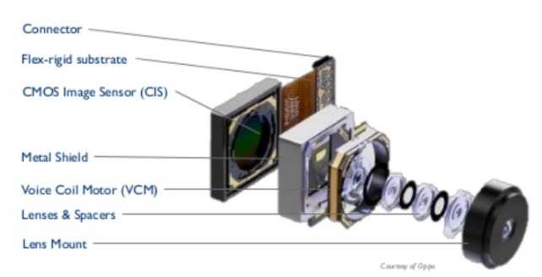
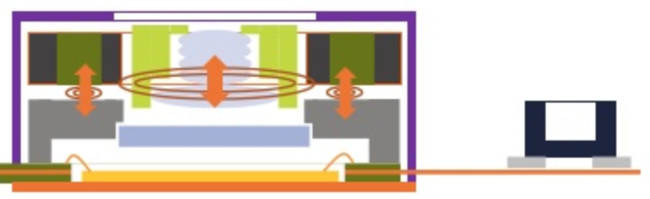
3. PCB PATTERN COIL & MODULE FOR OIS
3-1. Development Item Summary
: What is OIS (Optical Image Stabilizer)?
*AF ACTUATOR Summary
AF moves the lens up and down to the optimum focus position to ensure that an object appears
clearly.(In 2007, 2% is applied> In 2017, 78% is estimated.)
*OIS ACTUATOR Summary
Optical image stabilization function - The user's hand tremor is detected according to the
movement of the camera and the lens moves finely like a human eye, moving the lens in the
opposite direction of the tremor, thereby, the image is prevented from shaking.
*The OIS function is adopted to ‘iPhone 6+’, Samsung Electronics ‘Galaxy Note 4‘ since LG
Electronics introduced OIS to 'G2' in 2013.
Because the difference in image quality is due to whether the OIS function is installed or not as
the smartphone's high resolution progresses, 3% OIS adoption rate in 2014 has increased by
19% in 2017.
OIS ACTUATOR is still limited with manufactures as it is difficult to secure yield
and mass production.
Up/Down>AF
VCM
Trembling reversed move > OIS
Key of the proposed technology
Patent No. 10-2007207
(PCT/KR2019/010069호)
Manual work due to structure change -->
Productivity increase with automation

Slide 6
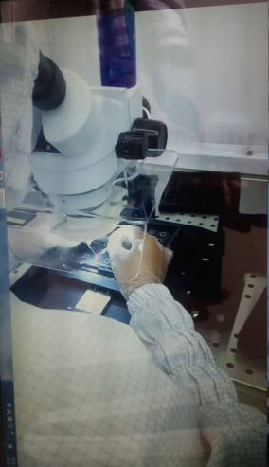

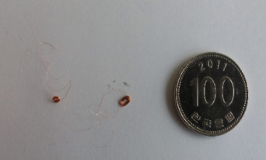
3-1. Development Item Summary
: OIS (Optical Image Stabilizer) 경쟁사 제조 방식
There are two ways to implement the OIS: shifting and tilting. Four enameled wires each having an ultra-fine diameter of 35 to 40 μm are coiled and soldered 80 to 100 times in the form of an elliptical loop and solder.
All VCM ACTUATORs around the world use 100% enamel coils. All processes (fabrication/ inspection) except for the winding process are manual using microscopes.
Due to the characteristics of ultra-small diameter enameled wire in mass production, defect rates are extremely high in winding wire, soldering, and foreign matter.
We endeavor to develop methods to secure technological and business competitiveness by changing materials, simplifying manufacturing processes, minimizing defect rate, and automating production. In addition, we are initiative in solving the problems by using multi-layer printed circuit board (M-PCB) pattern coil and modularization for automation.

Slide 7
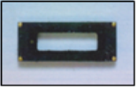
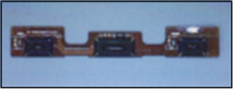
3-2. Technology Development and Implementation
1)Substitute material: Enamel Coil -> "PCB Pattern Coil" to eliminate the source
of the original defect.
-The current method of manufacturing VCM actuators is to use enameled wire having a diameter of 35 to 40μm. It is made by winding, and due to the characteristics of ultra-small diameter enameled wire, it is considered that the winding is bad, the disconnection is bad, the soldering is bad,100% of them all contain fundamental problems that can not be solved. In addition to the manufacturing process as well as the inspection process, it is imperative that the process of passing the inspection by human beings
(Existing product) (Developed by us)
2)Process change: Handwork->Decrease in production costs due to production automation by "modularization".
As a technical attempt to solve the above problems, the technology proposed a "PCB pattern coil" of a multi-layer printed circuit (M-PCB) method and a "modularization" method for automation, Because it is possible to mass-produce, it is a technology development to solve the problems of rising cost and defect rate due to the existing manual work
(Existing product) (Developed by us)
(Technical Influence)
: It is expected that the technology will be applied to all parts using cameras such as autonomous vehicles, drones, and medical equipment as well as smart phones

Slide 8
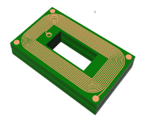
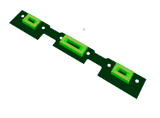
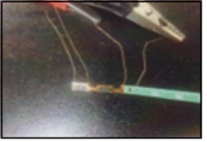
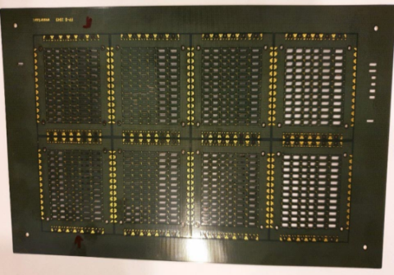
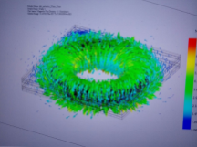
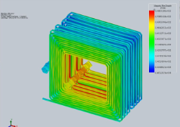
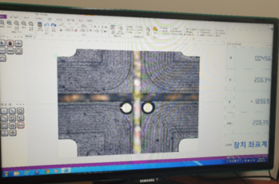
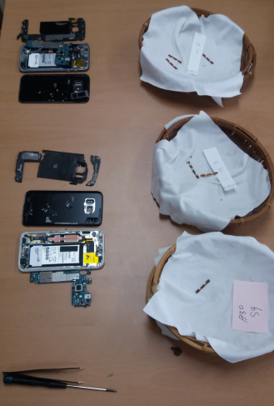
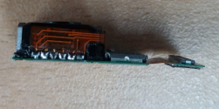
(Ref.)Development Process
(SIMULATION) (PROTO SAMPLE) (MEASURE)
(ASSEMBLY) (SAMPLE) (MOUNTING/SAMSUNG S7)

Slide 9
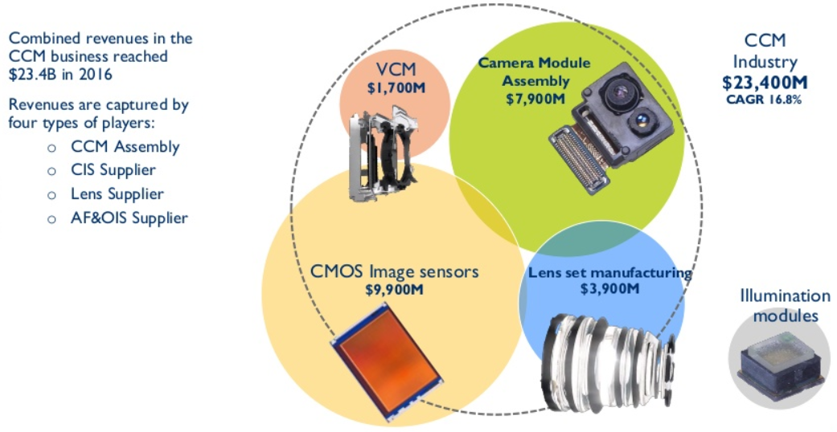
3-3. Market Size
Ecosystem of the camera module market:
Yole Developement, 'Camera module industry 2017'
Classification | Current market size (2017) | Remarks
World market size | $ 1.7 billion*10%=$1.7 billion (KRW 170 billion) | Approx. 10% of the VCM market
Domestic market size | KRW 170 billion *30%= KRW 51 billion | The Korean market is Approx. 30% of the world market
Calculation basis | European market research organization (YOLE) data - See Fig. -

Slide 10
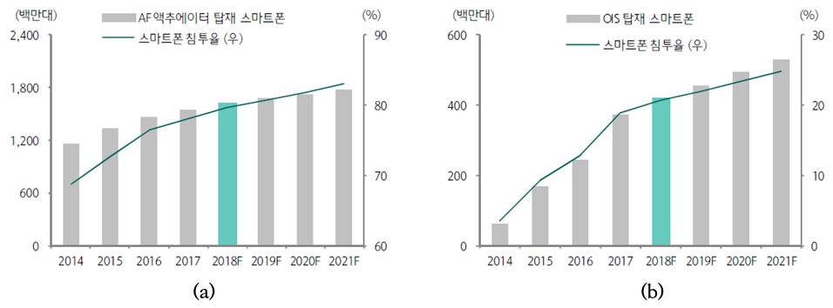
3-4. Competitor Status
(Million unit)
AF mounted smartphones
(Million unit)
OS mounted smartphones
Smartphone Penetration Rate (Dominant)
Smartphone Penetration Rate (Dominant)
[Fig.] (a) AF ACTUATOR and (b) OIS
ACTUATOR adoption trend and forecast
※ Source: Hana Financial Investment, Now,
IT item is camera’, Equity Research, Mar. 2018
ACTUATOR Application and Forecast
All VCM ACTUATORs around the world use 100% enamel coil, making it difficult to secure yield and mass production and
thus OIS ACTUATOR manufacturers are limited.
2.Some manufacturers are Samsung Electronics, TDK, Jahwa Electronics, HSO, and MC NEX, which supply to domestic
and Chinese smartphone manufacturers. Japanese ALPS and MITSUMI supply to Apple, but there is no PCB type
ACTUATOR like us.
3.In 2017, sales of Alps smartphone parts division and Jahwa Electronics increased 29.5% year-on-year and 49.3% year-
on-year, respectively, due to the increased demand of OIS ACTUATOR.
4.The adoption will be increased depending on improvement of auto focus function, convenience of movie shooting,
upgrade standardization of mid/low specs. The dual OIS application of flagship models will also contribute to the
expansion of demand.
5.Samsung Electronics' ‘Galaxy Note 8’ and‘Galaxy S9+’and Apple's ‘iPhoneX’ use the dual OIX for their dual cameras. In
dark night or low-light environment, the OIS improve clarity and differentiate functions.
Premium models of Chinese companies are likely to be adopted with the expansion of OIS adoption of Samsung and
Apple.

Slide 11
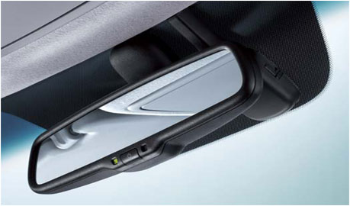
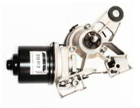

4. Rain Sensor
4-1. Development Overview
What is Rain Sensor?
This sensor replaces the ETACS (Electronic Time Alarm Control System) that controls the wiper motor drive and is installed inside the top of WINDSHIELD. The sensor is a crucial part that automatically controls wiper operating time and low/high operation speed according to rainfall detection. As a means to increase the efficiency of raindrop detection on the surface of windshields, we installed a light source and a light receiving element on the surface of the windshield. The system is designed to prevent direction penetration of some light of the light source besides the light that discharge outside the windshield, thereby providing a solution to the problem that deteriorate raindrop detection due to interfering light of the light source (sensing noise). We developed a rain sensor that maximizes the rain sensing function with an optical interference structure of light source.
Rain-sensing Wiper

Slide 12
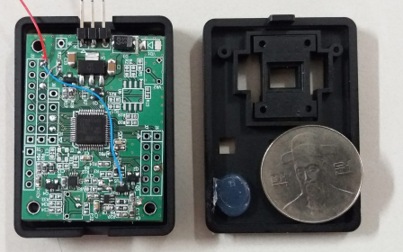
4-2. DESIGN CONCEPT
DESIGN CONCEPT
“Based on Motor company's spec”
1. Consider common use for all the world
-Safety regulation(EMC, Car maker's request etc.)
-LIN communication/ use common LIN map
2. Reduce the possible size
-Convergence development considered
-Minimize WIRING HARNESS & CONNECTOR showing
-Not to interfere during MIRROR moving for adjusting.
-Consider cost savings
3. Function
-NO malfunction by vibration
-Matte Black Color Case/ silicon Gel applied.

Slide 13
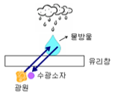
4-3. Core Technology
Rain sensor using frequency modulation and linear array methods
Core Technology
1.Arranged the light emitting element and light receiving element in a line at an angle to reduce ambient light influence
-When the raindrop falls on the windshield, it receives the intensity of radiation reflected from the raindrop in the direction
of the light source and detects the volume of raindrops
-In addition to the gloss reflected on the raindrop, the gloss reflected on the windshield prevents the light from being
received structurally.
2.It outputs hundreds of milliseconds of instantaneous current at the modulated (pulse-modulating) frequency of the light
emitting element
-Instantaneous source of light emits light higher than ambient light (sunlight, other IR light) to prevent error by ambient l
ight source.
3.Detects the point of raindrop by dividing into several areas by installing a multiple number of light source and a light
receiving element
Differentiation of core technologies
1.Detection of raindrop without ambient reflected light effect of windshield
- Precise decomposition detection of the volume of raindrops
- Prevents unnecessary movement of wiper motor
2. Minimizes device size by aligning light emitting element and light receiving element in a row
3. Simple implementation of functions based on simple pulse modulation (price reduction)
Water drop
Windshield
Light receiving element
Light source

Slide 14
4-4. Existing Technology (Product)
Demand for special sensors for cars is growing rapidly with high-end automobile specifications
Prior to 2006, the rain sensor was applied only to vehicles of 2,000CC or higher.
Since then, the application has expanded to 1,500CC mid-range vehicles. If the price decreases, the sensor can be applied to more models and the market will be expanded.
The rain sensor uses infrared technology as it is affected by external light, e.g. weather and sunlight.
Due to patent issues of TRW and BOSCH, market entry is challenging except existing five companies (Other companies use different detection technologies, e.g. IMAGE PROCESSING TYPE)
BOSCH has been withdrawn from the Korean market and HELLA has entered the market due to intensified price competition among global companies.
[ TRW ]
[ TRW ]
[ BOSCH ]
[ KOSTAL ]
[ HELLA ]

Slide 15


THANK YOU!!!

